Slide 1

EAI Capstone Project Intrusion Detection System Using Artificial Intelligence
Craig Perkins
January 2023
EAI6980

Slide 2
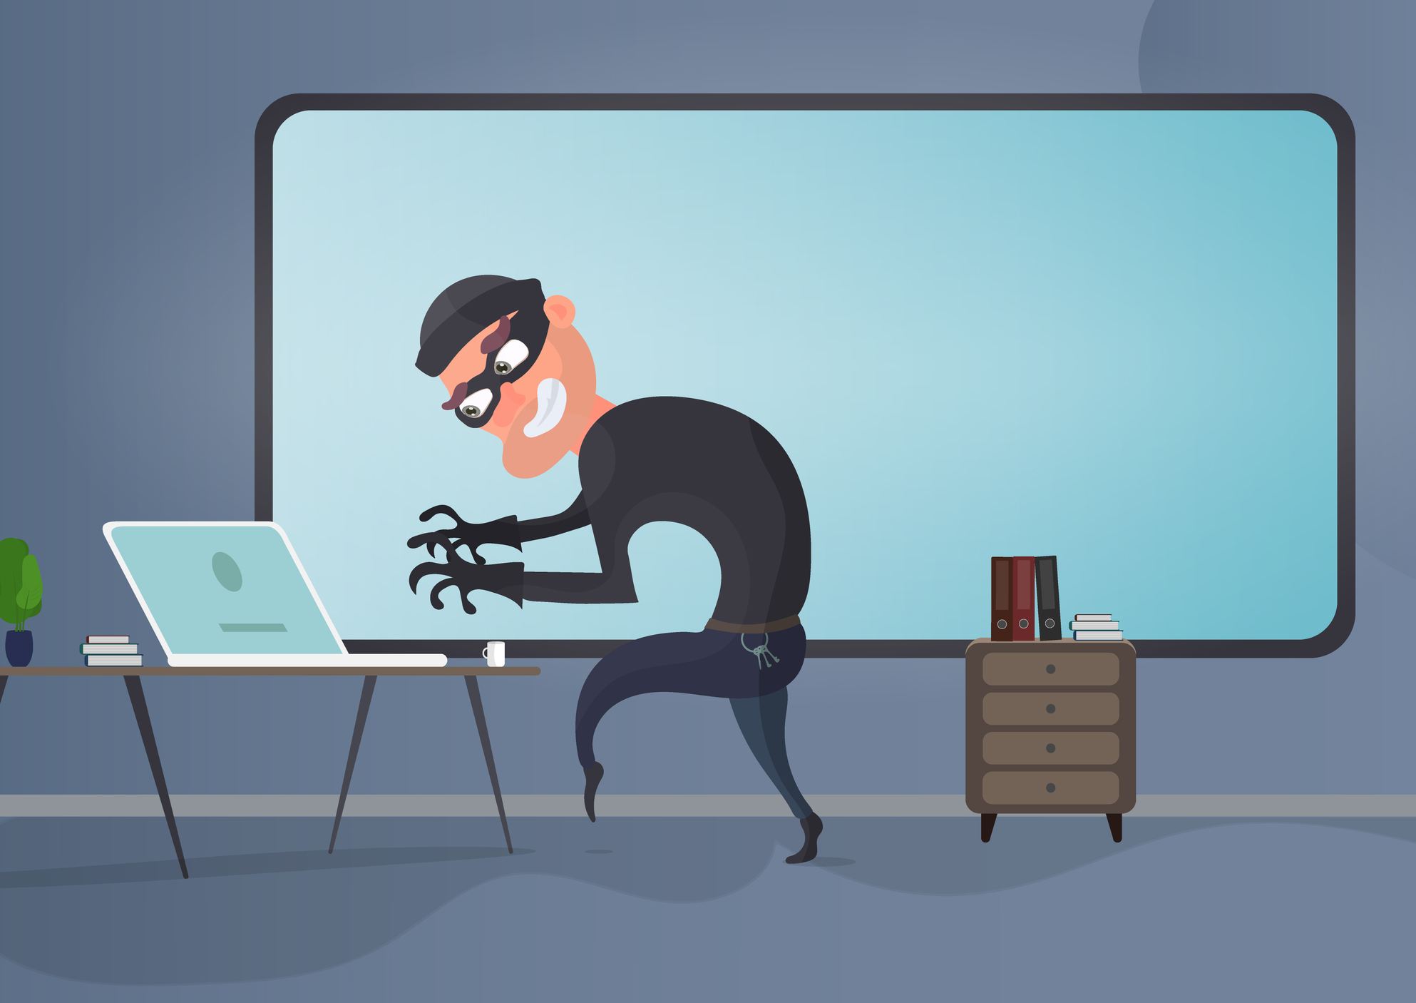
CAPSTONE OVERVIEW
Evidence suggests the US loses hundreds of billions to cybercrime annually – according to NIST
The high-profile hack of Equifax has cost the company $3.8B and potentially affected 143 million people
Attackers keep seeking novel attack vectors to exploit vulnerable software
Companies need tools to mitigate the risk of cyberattack

Slide 3

Dataset
UNSW-NB15 Dataset from University of South Wales
Originates from 100GB of raw tcpdump data
Contains 49 features
Train data set has 175,341 records and test dataset has 82,332 records
Has nine types of attacks, namely, Fuzzers, Analysis, Backdoors, DoS, Exploits, Generic, Reconnaissance, Shellcode and Worms

Slide 4
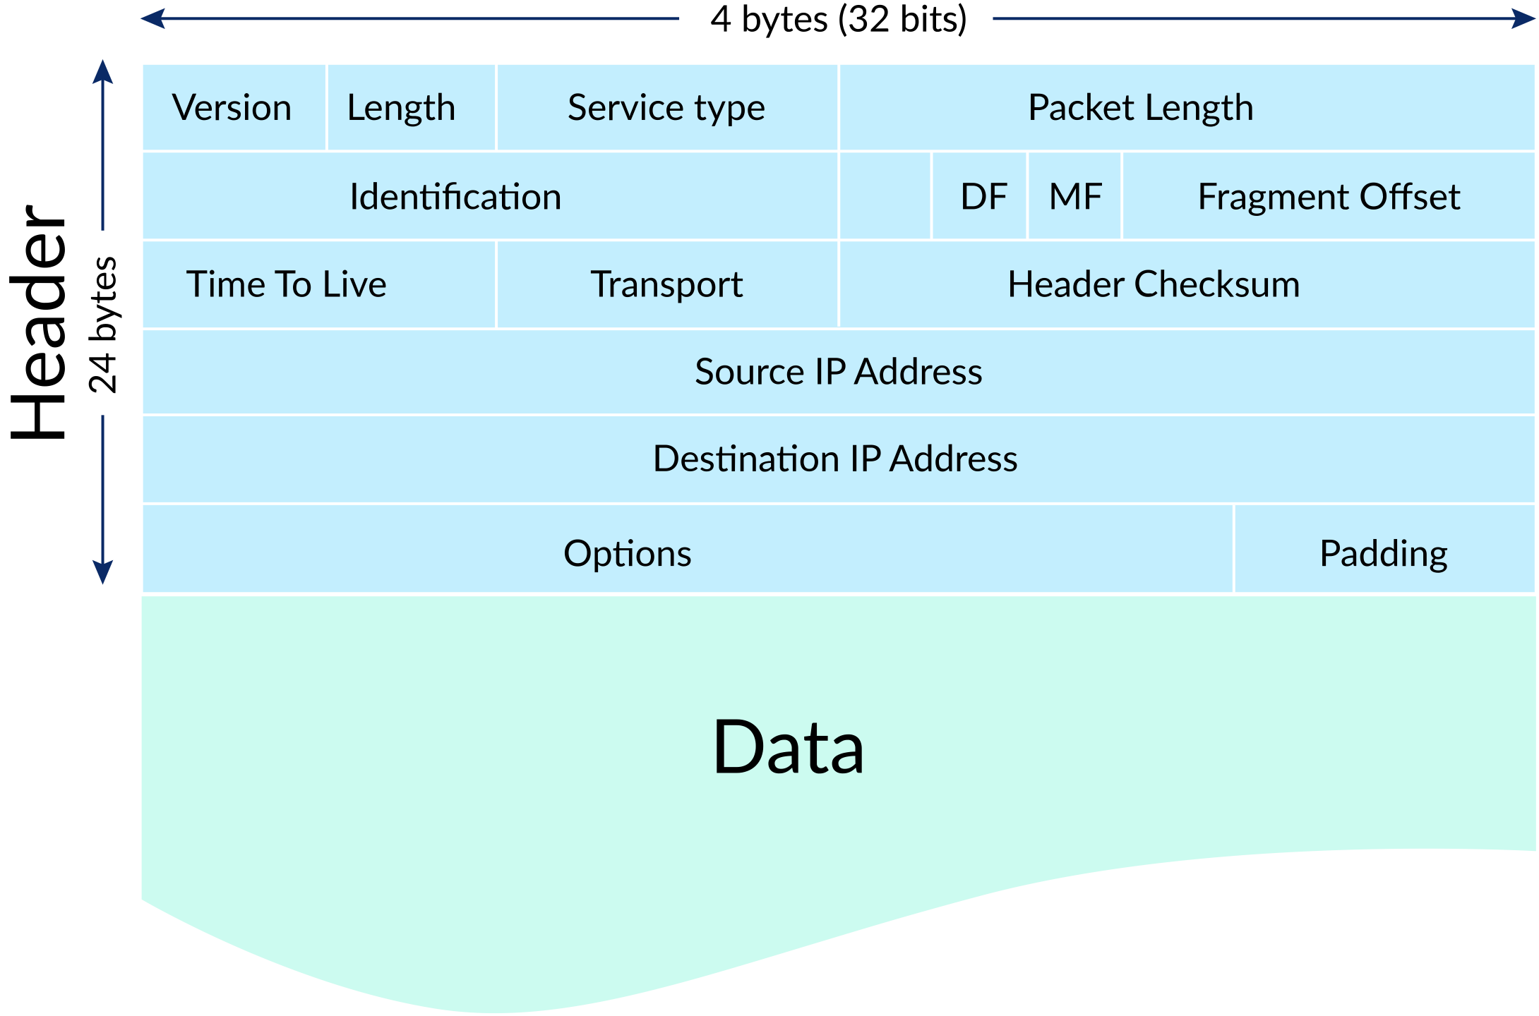
tcpdump
A powerful command-line packet analyzer
In networking, a packet is a small segment of a larger message
You can think of IP packets like postal letters: the header is the envelope with all the routing information that's needed by the post office, and the payload is the letter that's read only by the recipient.
TCP/IP - Transmission Control Protocol/Internet Protocol

Slide 5
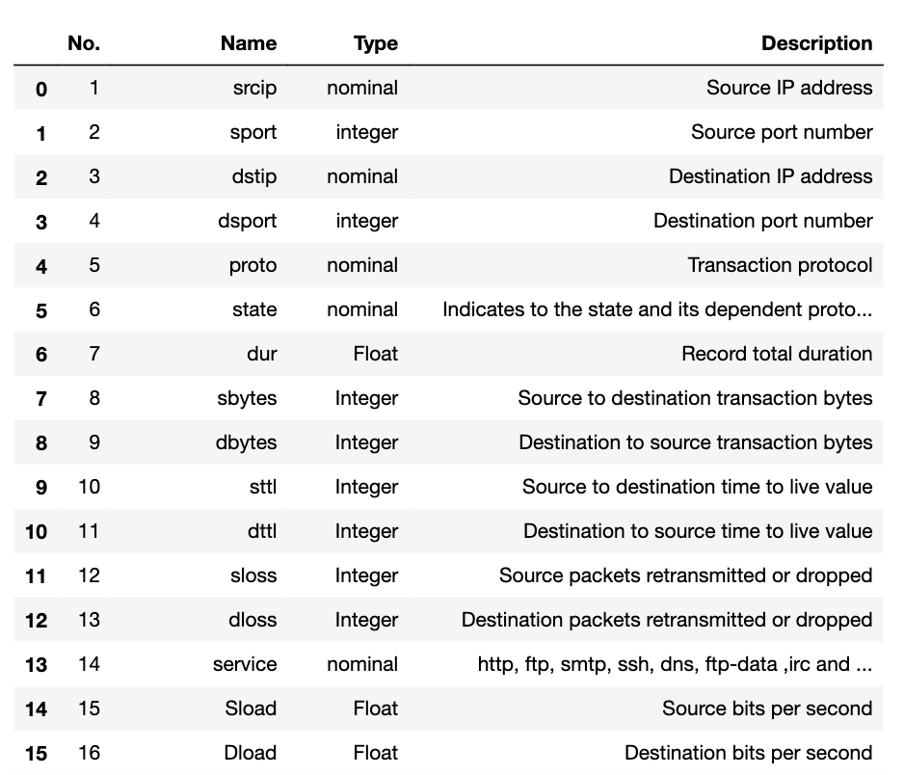
Features in the Dataset

Slide 6
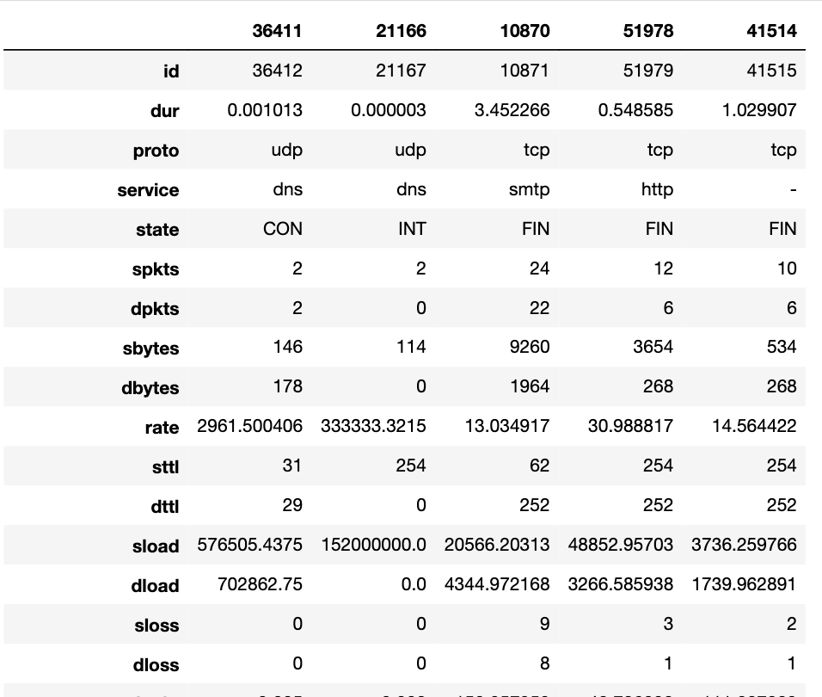
Sample Records

